Slide 1


Computer virus:
Contents:
What is computer virus
History of computer virus
What can viruses do
How viruses spread
Types of computer viruses
Explanation of worms trojans and logical bombs
Case studies of popular viruses like Melissa ,I LOVE YOU, Stuxnet
Signs of virus infection
Antivirus software
Prevention tips
...

Slide 2

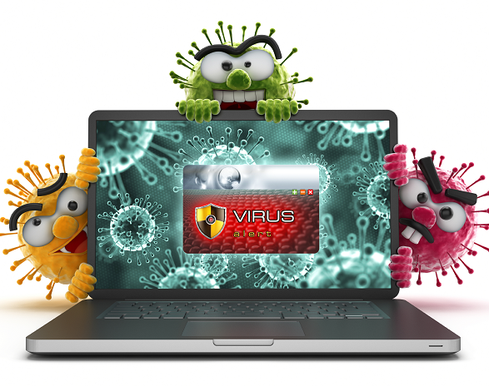



What is computer virus?
A computer virus is a computer program that can copy itself and infect a computer without the permission or knowledge of the user.

Slide 3

History of computer virus:
The first known computer virus was "creeper" virus. It was created by Bob Thomas in 1971.
In 1983 ,the term "computer virus" was coined by American computer scientist Fred Cohen .The 1980s saw an increase in virus development ,with viruses like Brain and stoned infecting MS-DOS based systems.

Slide 4

What can viruses do ?
They can delete or change files. Some viruses will delete all your files or even reformat your hard drive making your computer unusable.
Some viruses steal personal information like credit card numbers , account numbers and passwords.
Some viruses can slow down your computer dramatically.

Slide 5
How does computer viruses spread?
Computer viruses often spread through malicious email attachments.
Visiting compromised or malicious websites can expose a computer to viruses.
Viruses can be transferred via infected removable media such as USB drives.

Slide 6

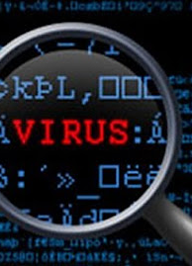
Types of computer viruses:
Boot sector virus
File infector virus
Macro virus
Worms
Trojan horses
Logic bombs
spyware
This Photo by Unknown author is licensed under CC BY-NC-ND.

Slide 7

Explanation of worms ,Trojans and logic bombs:
Worms, Trojans, and logic bombs are types of malicious software.
Worms are self-replicating programs that spread across networks.
Trojans disguise themselves as a useful software but carry hidden malicious functions.
Just as real bomb, logical bombs are code snippets triggered by specific events, causing harm when activated.
Understanding these threats is crucial for effective cybersecurity.

Slide 8

Case studies of popular viruses:
1. Mellisa (1999):
Nature: Email- borne virus.
Impact: Rapidly spread via email attachments disrupting email systems globally.
Notoriety: named after a stripper, highlighted email security vulnerabilities.

Slide 9
2. I love you (2000):
Nature: Worm spread via email as a love letter.
Impact: Massive global infection, causing data loss and system disruptions.
Significance: Exposed the vulnerability of users to social engineering attacks.

Slide 10

3. Stuxnet (2010):
Nature: Complex worm targeting industrial systems, particularly Iran's nuclear facilities.
Impact: Successfully sabotaged centrifuges, delaying Iran's nuclear program.
Noteworthy: First known malware designed for cyber-physical attacks, bridging digital and physical realms.

Slide 11

Signs of virus infection:
Unexplained slows downs in computer .
System crashes or freezes more than usual.
Unexpected pop-ups or advertisements.
Chages in homepage or search engine.
Missing files or icons.
Unusual network activity.

Slide 12

Prevention tips:
Use reliable antivirus software.
Be cautious online.
Enable firewall protections.
Secure passwords.
Always use official app stores or websites for download purpose.

Slide 13
What is antivirus software?
Antivirus is a software that protects your computer from malicious software by detecting, preventing and removing viruses, malware, and other threats . It acts as a security guard, regularly scanning your system for potential risks and ensuring a safer computing experience.

Slide 14

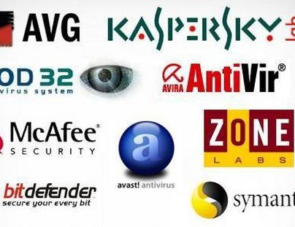
Some popular antivirus software :
Norton Antivirus
McAfee Antivirus
Kaspersky antivirus
Bitdefender antivirus
Avast antivirus
This Photo by Unknown author is licensed under CC BY.

Slide 15
Thank you !!

